Slide 1
Chapter 10
Inference for Regression
Lecture Slides
Introduction to the Practice of Statistics
Tenth Edition
David S. Moore George P. McCabe
Bruce Craig

Slide 2
Chapter 10
Inference for Regression
10.1 Simple Linear Regression
10.2 More Detail about Simple Linear Regression

Slide 3
10.1 Simple Linear Regression
Statistical model for linear regression
Simple linear regression model
Estimating the regression parameters
Confidence intervals and significance tests
Confidence interval for mean response
Prediction interval

Slide 4
Simple Linear Regression Introduction 1
When a scatterplot shows a linear relationship between a quantitative explanatory variable x and a quantitative response variable y, we can use the least-squares line fitted to the data to predict y for a given value of x. If the data are a random sample from a larger population, we need statistical inference to answer questions like these:
Is there really a linear relationship between x and y in the population, or could the pattern we see in the scatterplot plausibly happen just by chance?
What is the slope (rate of change) that relates y to x in the population, including a margin of error for our estimate of the slope?
If we use the least-squares regression line to predict y for a given value of x, how accurate is our prediction (again, with a margin of error)?

Slide 5
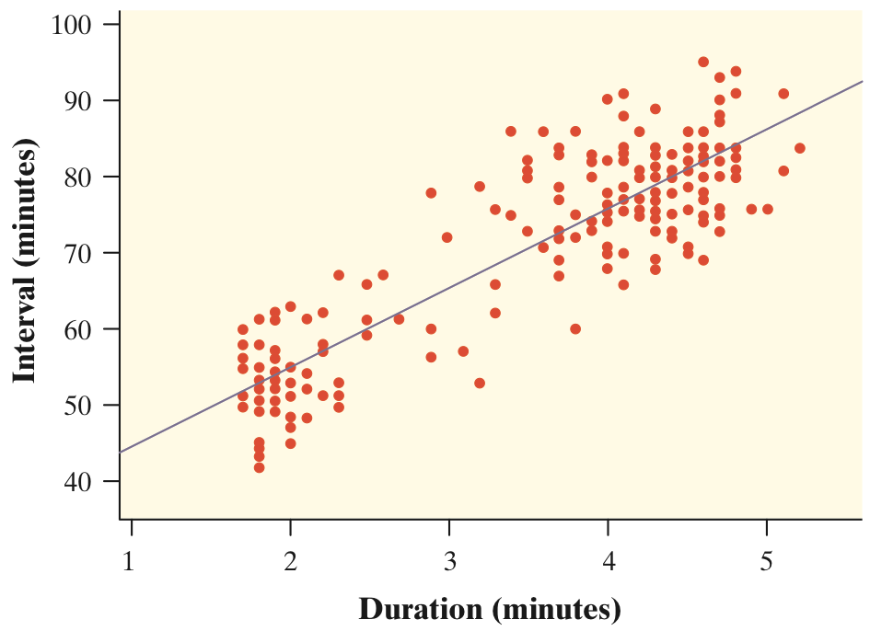
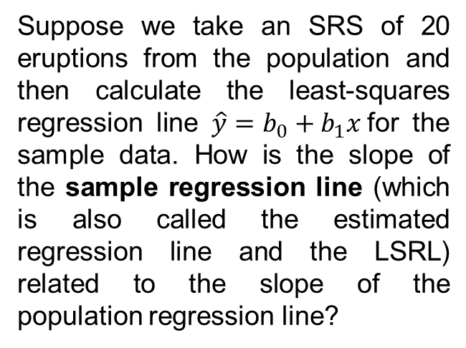
Simple Linear Regression Introduction 2
Example: Researchers have collected data on eruptions of the Old Faithful geyser. Below is a scatterplot of the duration and interval of time until the next eruption for all 222 recorded eruptions in a single month. The least-squares regression line for this population of data has been added to the graph. It has slope 10.36 and y intercept 33.97. Regarding all 222 eruptions as the population, this line is the population regression line (or true regression line) because it uses all the observations that month.
Suppose we take an SRS of 20 eruptions from the population and then calculate the least-squares regression line $\hat{y}=b_{0}+b_{1}x$for the sample data. How is the slope of the sample regression line (which is also called the estimated regression line and the LSRL) related to the slope of the population regression line?

Slide 6
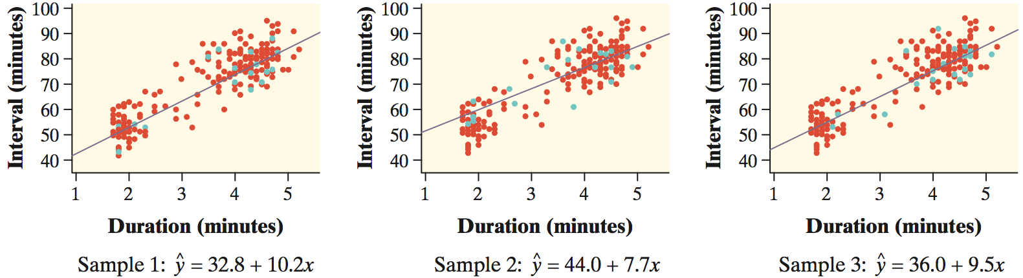
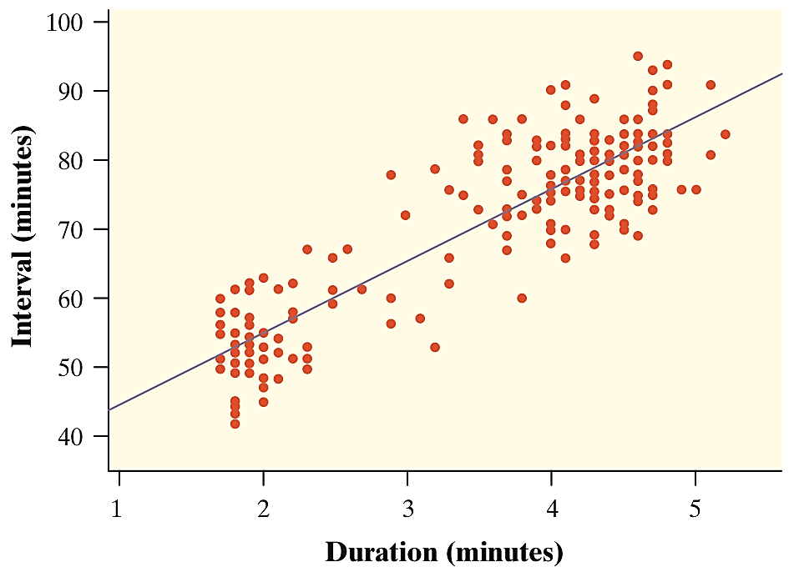
Simple Linear Regression Introduction 3
The figures below show the results of taking three different SRSs of 20 Old Faithful eruptions in this month. The green points in each graph are the selected points, and the line is the LSRL for that sample of 20.
Notice that the slopes of the sample regression lines―10.2, 7.7, and 9.5―vary quite a bit from the slope of the population regression line, 10.36.
The pattern of variation in the slope b is described by its sampling distribution.

Slide 7
Conditions for Regression Inference 1
The slope and intercept of the least-squares line are statistics. That is, we calculate them from the sample data. These statistics would take somewhat different values if we repeated the data production process. To do inference, think of b₀ and b₁ as estimates of unknown parameters β₀ and β₁ that describe the population of interest.
Conditions for Regression Inference
We have n observations on an explanatory variable x and a response variable y. Our goal is to study or predict the behavior of y for given values of x.
For any fixed value of x, the response y varies according to a Normal distribution. Repeated responses y are independent of each other.
The mean response µ_{y} has a straight-line relationship with x given by a population regression line µ_{y}= β₀ + β₁x.
The slope and intercept are unknown parameters.
The standard deviation of y (call it σ) is the same for all values of x. The value of σ is unknown.

Slide 8
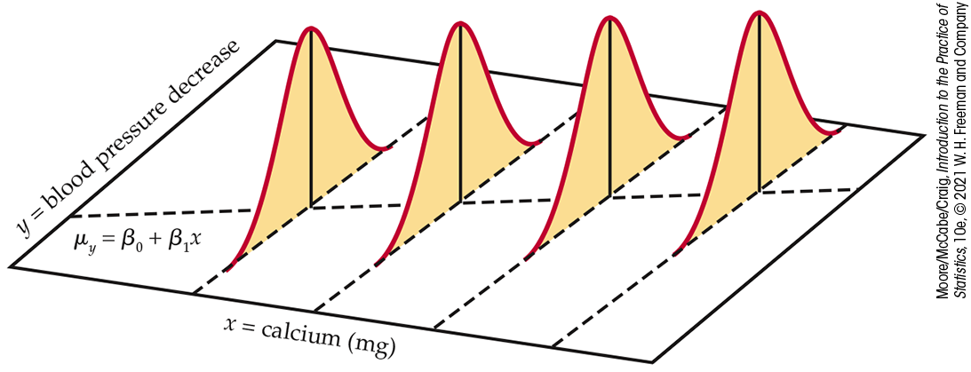
Conditions for Regression Inference 2
The figure below shows the regression model when the conditions are met. The line in the figure is the population regression line µ_{y}= β₀ + β₁x.
For each possible value of the explanatory variable x, the mean of the responses µ(y | x) moves along this line.
The Normal curves show how y will vary when x is held fixed at different values. All the curves have the same standard deviation σ, so the variability of y is the same for all values of x.
The value of σ determines whether the points fall close to the population regression line (small σ) or are widely scattered (large σ).

Slide 9
Simple Linear Regression Model
In the population, the linear regression equation is μ_{y} = β₀ + β₁x.
Sample data fit the simple linear regression model:
Data = Fit + Error
y_{i} = (β₀ + β₁x_{i}) + (ε_{i})
where the ε_{i} are independent and
Normally distributed N(0, σ).
NOTE! Linear regression assumes equal variance of y (σ is the same for all values of x).

Slide 10
Estimating the Parameters
μ_{y} = β₀ + β₁x
The intercept β₀, the slope β₁, and the standard deviation σ of y are the unknown parameters of the regression model. We rely on the random sample data to provide unbiased estimates of these parameters.
  The value of ŷ from the least-squares regression line is really a prediction of the mean value of y (μ_{y}) for a given value of x.
  The least-squares regression line (ŷ = b₀ + b₁x) obtained from sample data is the best estimate of the true population regression line (μ_{y} = β₀ + β₁x).
ŷ is an unbiased estimate for mean response μ_{y}.
b₀ is an unbiased estimate for intercept β₀.
b₁ is an unbiased estimate for slope β₁.

Slide 11
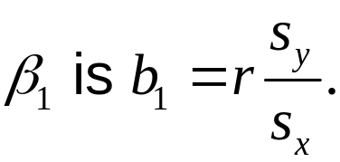

Estimating the Parameters—βs
The slope β₁ for the regression line represents the change in the response variable y for an increase of one unit in the explanatory variable x.
The intercept β₀ for the regression line represents the value of the response variable y when the explanatory variable x is zero.
Recall from Chapter 2 the least-squares estimates:
The least-squares estimate for
The least-squares estimate for

Slide 12
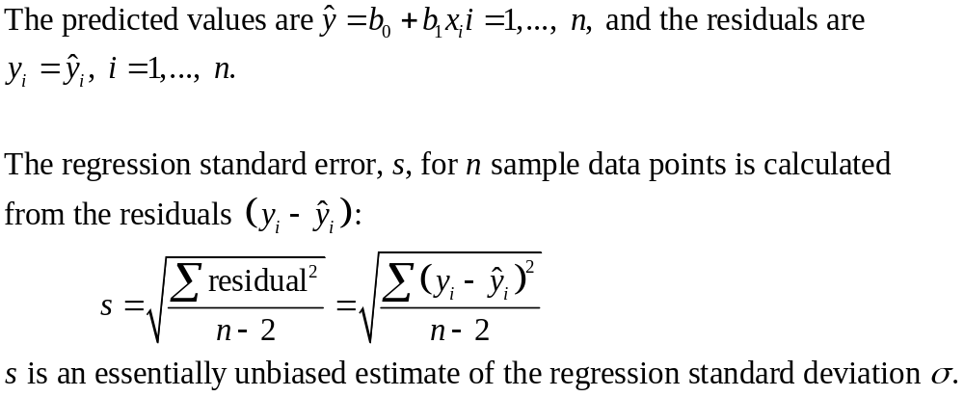
Estimating the Parameters—σ
The population standard deviation σ for y at any given value of x represents the spread of the normal distribution of the ε_{i} around the mean μ_{y}.

Slide 13
Checking the Conditions for Regression Inference
You can fit a least-squares line to any set of explanatory-response data when both variables are quantitative. If the scatterplot does not show a roughly linear pattern, the fitted line may be almost useless.
Before you can trust the results of inference, you must check the conditions for inference one by one.
The relationship is linear in the population.
The response varies Normally about the population regression line.
Observations are independent.
The standard deviation of the responses is the same for all values of x.
You can check all the conditions for regression inference by looking at graphs of the residuals or residual plots.

Slide 14
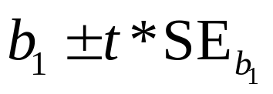
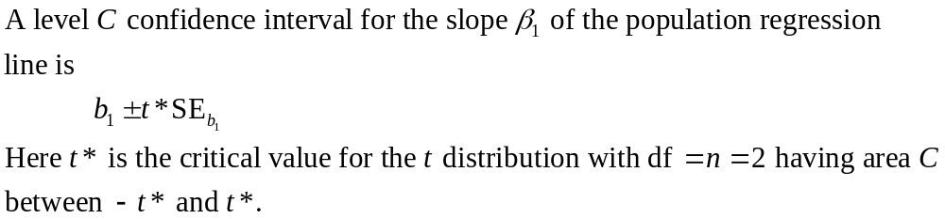
Confidence Interval for Regression Slope
The slope β₁ of the population regression line µ_{y} = β₀ + β₁x is the rate of change of the mean response as the explanatory variable increases. We often want to estimate β₁. The slope b₁ of the sample regression line is our point estimate for β₁.
The confidence interval for β₁ has the familiar form
estimate ± t* · (standard error of estimate)
Because we use the statistic b₁ as our estimate, the confidence interval is
Confidence Interval for Regression Slope

Slide 15
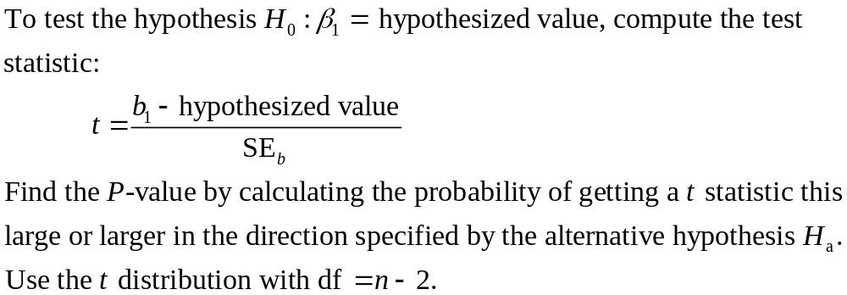
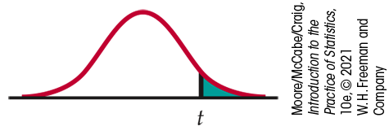
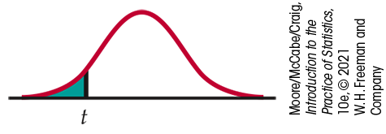
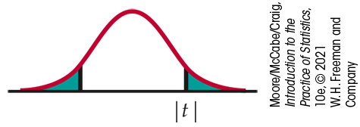


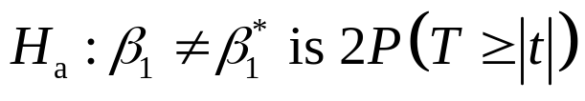
Significance Test for Regression Slope
Significance Test for Regression Slope

Slide 16
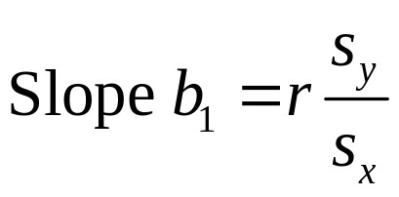
Testing the Hypothesis of No Relationship
We may look for evidence of a significant relationship between variables x and y in the population from which our data were drawn.
For that, we can test the hypothesis that the regression slope parameter β₁ is equal to zero.
H₀: β₁ = 0 versus H_{a}: β₁ ≠ 0
Testing H₀: β₁ = 0 is equivalent to testing the hypothesis of no correlation between x and y in the population.
Note: A test of hypothesis for β₀ is seldom of interest, mainly because β₀ often has no practical interpretation. Remember that β₀ represents the value of the response variable when x = 0, which is often outside the range of experimentation.

Slide 17
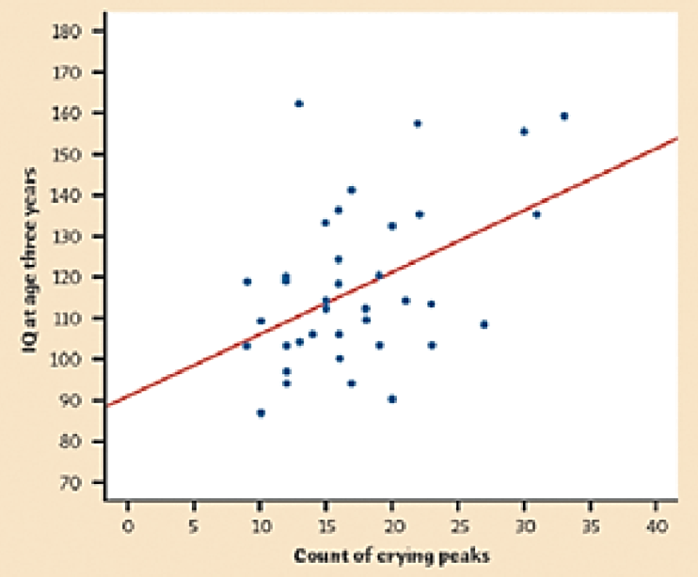
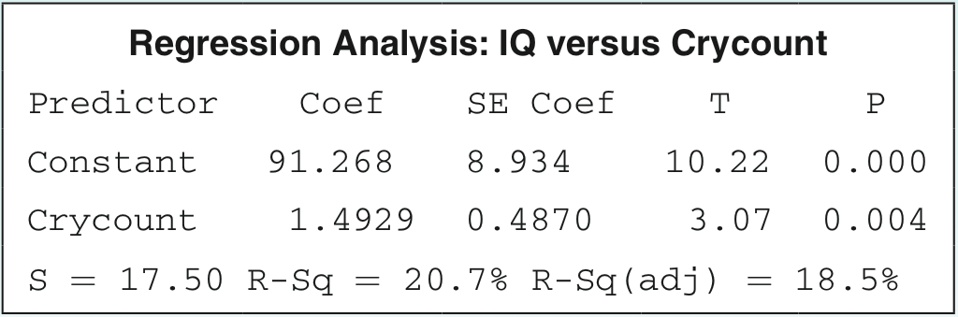
Simple Linear Regression Example 1
Example: Infants who cry easily may be more easily stimulated than others. This may be a sign of higher IQ. Child development researchers explored the relationship between the crying of infants 4 to 10 days old and their later IQ test scores. A snap of a rubber band on the sole of the foot caused the infants to cry. The researchers recorded the crying and measured its intensity by the number of peaks in the most active 20 seconds. They later measured the children’s IQ at age 3 years, using the Stanford-Binet IQ test. A scatterplot and Minitab output for the data from a random sample of 38 infants are given below.
Do these data provide convincing evidence that there is a positive linear relationship between crying count and IQ in the population of infants?
Notes:
The graph is too fuzzy.

Slide 18
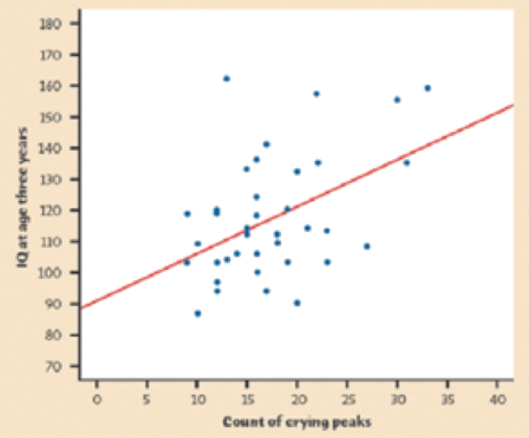
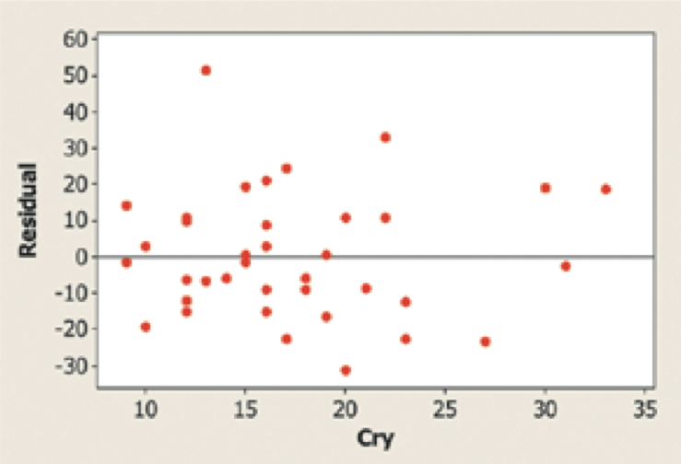
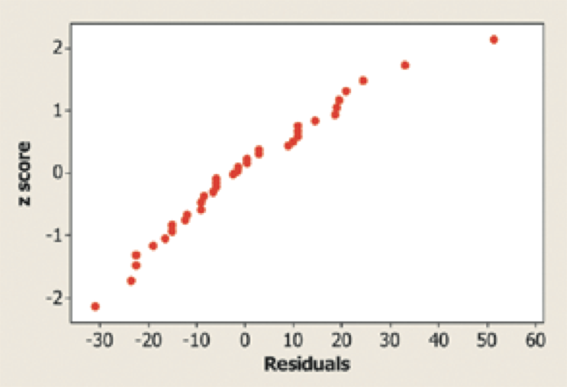
Simple Linear Regression Example 2
We want to perform a test of
H₀: β₁ = 0
H_{a}: β₁ > 0
where β₁ is the true slope of the population regression line relating crying count to IQ score.
• The scatterplot suggests a moderately positive linear relationship between crying peaks and IQ. The residual plot shows a random scatter of residuals about the line y = 0.
• IQ scores of individual infants should be independent.
• The Normal probability plot of the residuals shows a slight curvature, which suggests that the responses may not be Normally distributed about the line at each x-value. With such a large sample size (n = 38), however, the t procedures are robust against departures from Normality.
• The residual plot shows fairly equal amounts of scatter around the horizontal line at 0 for all x- values.

Slide 19
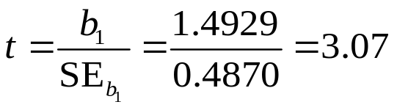
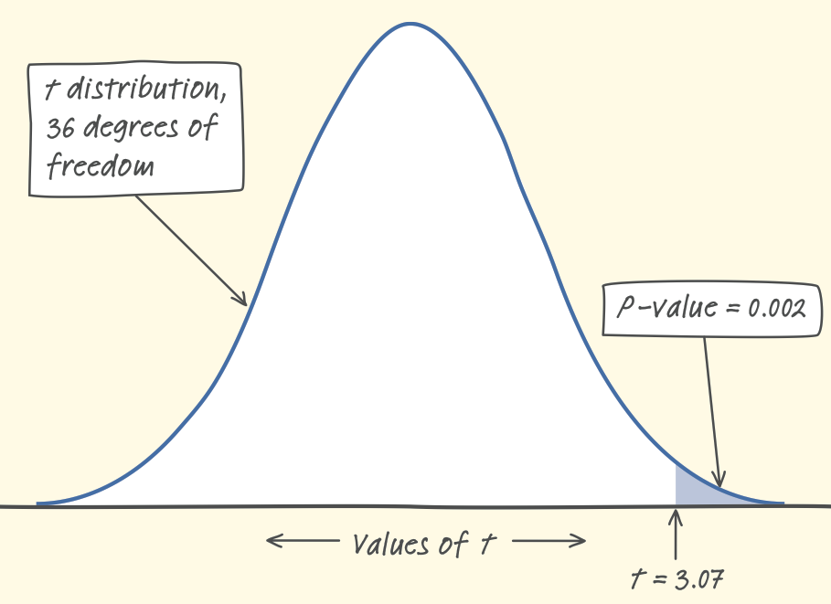
Simple Linear Regression Example 3
With no obvious violations of the conditions, we proceed to inference. The test statistic and P-value can be found in the Minitab output.
The Minitab output gives P = 0.004 as the P-value for a two-sided test. The P-value for the one-sided test is half of this,
P = 0.002.
The P-value, 0.002, is less than our α = 0.05 significance level, so we have enough evidence to reject H₀ and conclude that there is a positive linear relationship between intensity of crying and IQ score in the population of infants.

Slide 20
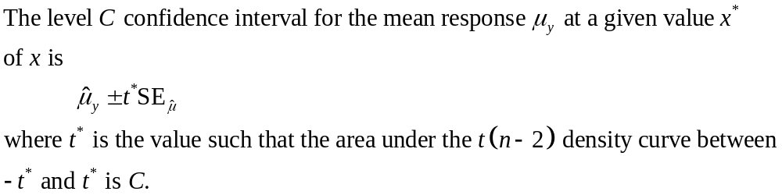
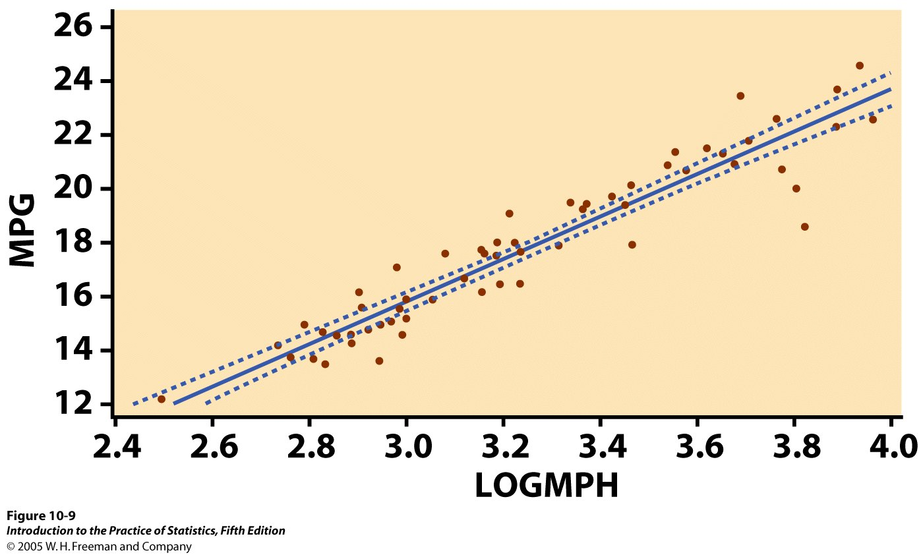
Confidence Interval for Mean Response
We can also calculate a confidence interval for the population mean μ_{y} of all responses y when x takes the value x* (within the range of the data tested).
A separate confidence interval could be calculated for μ_{y} along all the values that x takes.
Graphically, the series of confidence intervals is shown as a continuous curve on either side of ŷ.

Slide 21
Prediction Intervals 1
One use of regression is for predicting the value of y at some value of x within the range of the data tested. Reliable predictions require statistical inference.
To estimate an individual response y for a given value of x, we use a prediction interval.
  If we randomly sampled many times, many different values of y would be obtained for a particular x following N(0, σ) around the mean response µ_{y}.

Slide 22
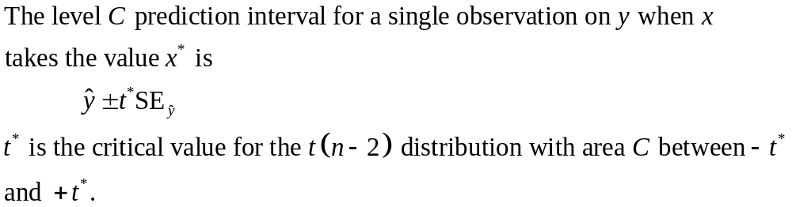
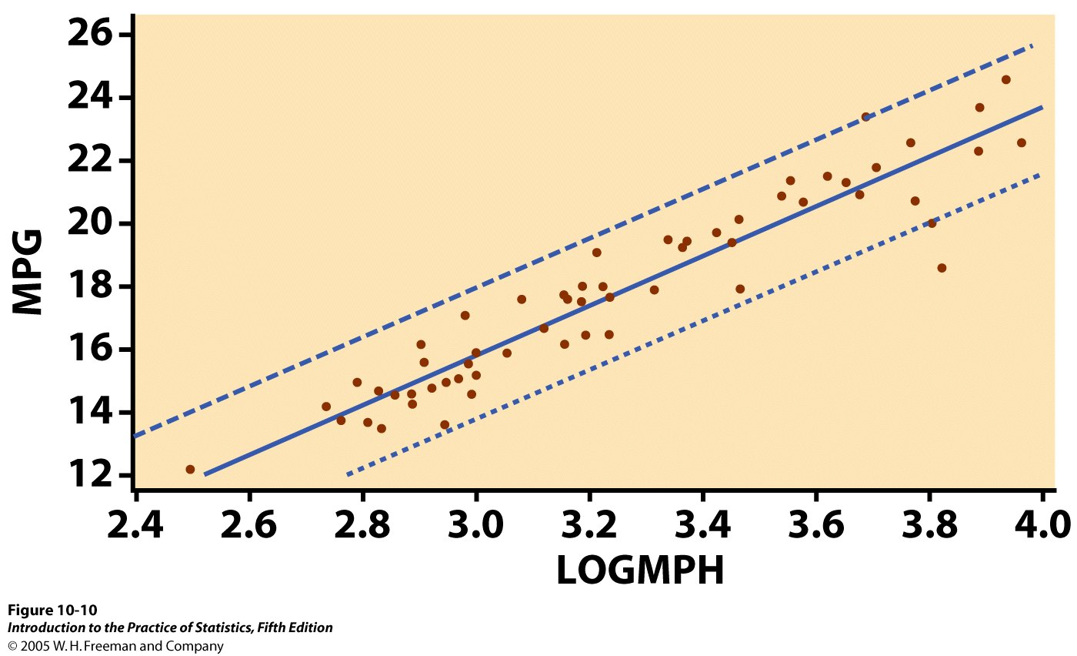
Prediction Intervals 2
The prediction interval accounts for error in estimating β₀ and β₁ as well as uncertainty about the value of y being predicted.
Graphically, the series of prediction intervals is shown as a continuous curve on either side of ŷ. These prediction intervals are wider than the corresponding confidence intervals for μ_{y} .

Slide 23
10.2 More Detail about Simple Linear Regression
Analysis of variance for regression
The ANOVA F test
Calculations for regression inference
Inference for correlation

Slide 24
Analysis of Variance for Regression
The regression model is
Data = fit + error
y_{i} = (β₀ + β₁x_{i}) + (ε_{i})
where the ε_{i} are independent and
Normally distributed N(0, σ), and
σ is the same for all values of x.
It resembles ANOVA, which also assumes equal variance, where
SST = SS model + SS error and
DFT = DF model + DF error

Slide 25
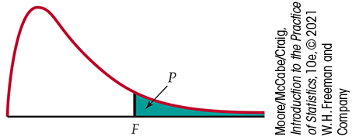
The ANOVA F Test
For a simple linear relationship, the ANOVA tests the hypotheses
H₀: β₁ = 0 versus H_{a}: β₁ ≠ 0
by comparing MSM (model) to MSE (error): F = MSM / MSE
When H₀ is true, F follows
the F(1, n − 2) distribution.
The P-value is P(F > f ).
The ANOVA test and the two-sided t test for H₀: β₁ = 0 yield the same P-value.
Software output for regression may provide t, F, or both, along with the P-value.

Slide 26
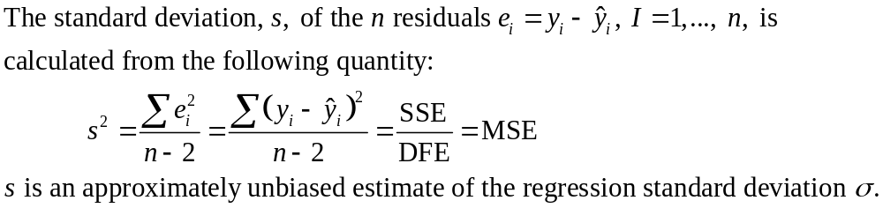
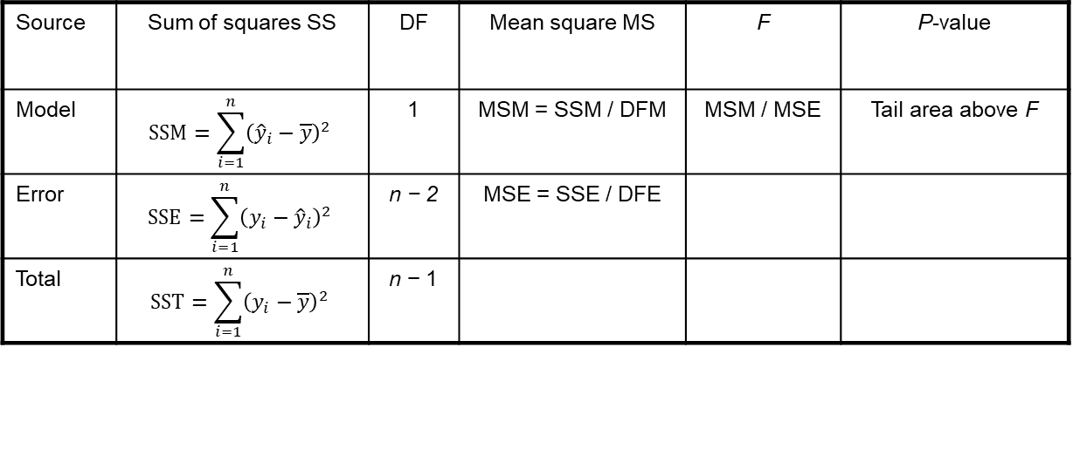
The ANOVA Table
Source | Sum of squares SS | DF | Mean square MS | F | P-value
Model | $$SSM=\sum_{i=1}^{n}{{\left({\hat{y}}_{i}−\overline{y}\right)}^{2}}$$ | 1 | MSM = SSM / DFM | MSM / MSE | Tail area above F
Error | $$SSE=\sum_{i=1}^{n}{{\left(y_{i}−{\hat{y}}_{i}\right)}^{2}}$$ | n − 2 | MSE = SSE / DFE
Total | $$SST=\sum_{i=1}^{n}{{\left(y_{i}−\overline{y}\right)}^{2}}$$ | n − 1
SST = SSM + SSE
DFT = DFM + DFE
F = MSM / MSE

Slide 27
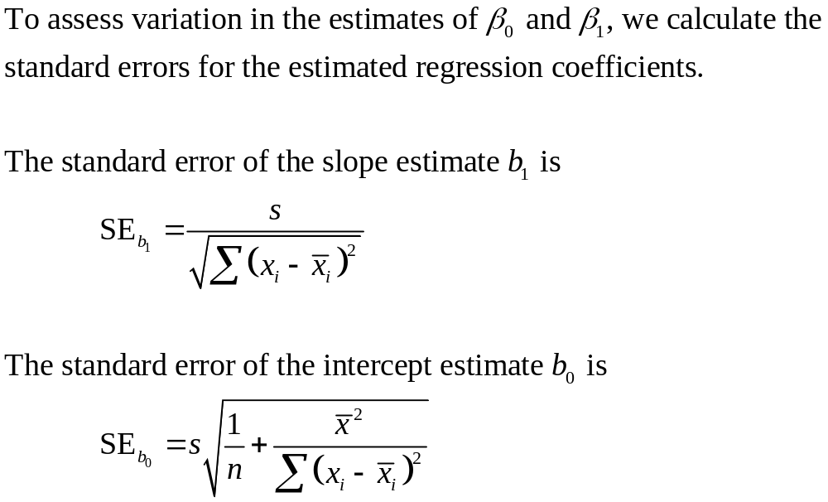
Calculations for Regression Inference 1

Slide 28
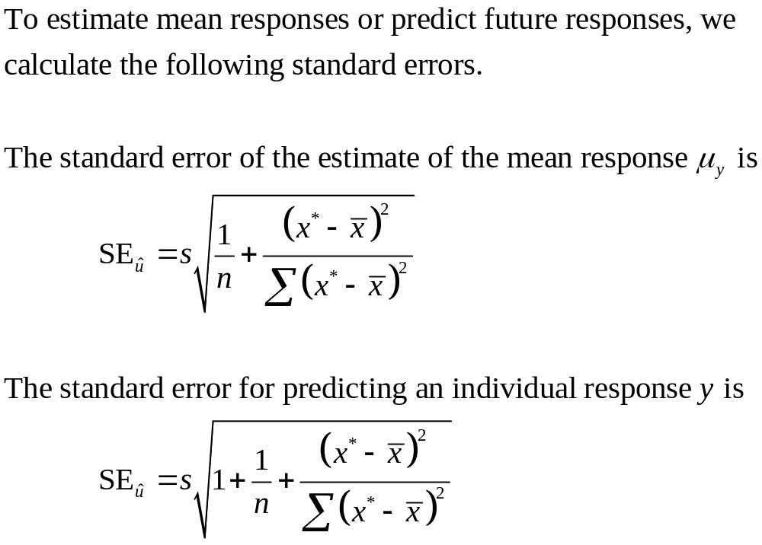
Calculations for Regression Inference 2

Slide 29
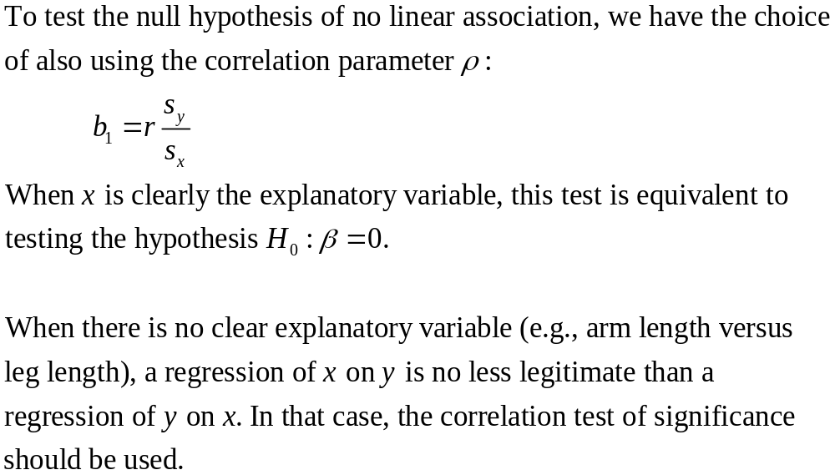
Inference for Correlation 1

Slide 30
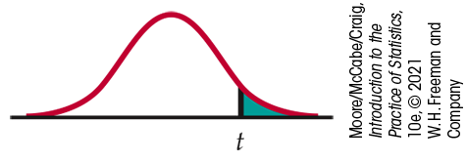
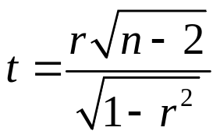

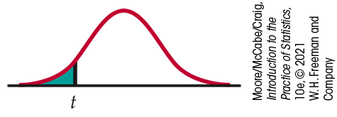

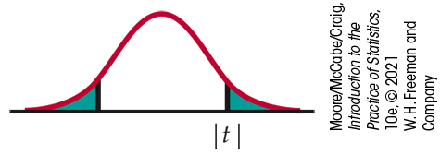

Inference for Correlation 2
The test of significance for ρ uses the one-sample t test for H₀: ρ = 0.
We compute the t statistic
for sample size n and
correlation coefficient r.
The P-value is the area
under t(n – 2) for values of
T as extreme as or more
extreme than t in the direction
of H_{a}.

Slide 31
Inference for Correlation 3
When the hypothesis H₀: ρ = 0 is rejected, it is safe to assume that there is some sort of relationship between the variables x and y.
However, recall from Chapter 2 that correlation measures linear relationships. Thus it is not always a reliable indicator of nonlinear relationships.
When the hypothesis H₀: ρ = 0 is not rejected, do not assume that the variables are unrelated.
First, it is possible that a Type II error has occurred!
Second, it is possible that x and y are related in a nonlinear way that the correlation coefficient r has no chance of detecting.
A good way to investigate the second possibility is to examine a residual plot.

Slide 32
Chapter 10
Inference for Regression (Review)
10.1 Simple Linear Regression
10.2 More Detail about Simple Linear Regression

